Slide 1

Complex Pricing – Recap and APplications
Professor Nico Voigtländer
Management 405: Module 6

Slide 2
Exam-Specific announcements
Practice Final Exam on BruinLearn
  Similar to actual final
Final exam: You will have 5 hours
  Any time between March 19, 12:01am and March 20, 11:59pm (submission time)
We’ll have 2 windows with guaranteed TA availability on Zoom
  Saturday, March 19: 9am-2pm
  Sunday, March 20: 9am-2pm
  Zoom link will be shared before the final exam
Remember: Many practice problems on Achieve!

Slide 3
Final exam: Structure
40% MCQs (20 questions, 2 points each)
  Directly on Bruinlearn, only one answer correct
  No partial credit
60% Problem Solving (3 problems)
  Upload a pdf with your answers and steps
  Show your work for full credit!
  Show you work for partial credit!
    Even if you get stuck or run out of time, show that you know the steps / intuition / formulas
All material relevant, more weight on post-midterm topics

Slide 4
Further Exam-Related announcements
Review sessions
  Tuesday, 3/8 at 3pm with Nico
    Send me topics you’d like to cover!
    Additional office hours on demand
  «Last minute» review with Nico on 3/17 at 8pm
  TA Review Sessions: See Email announcements

Slide 5
Plan for Today
Module 6: (Brief) Recap and Applications
Module 7, Part I: Recap and applications: Oligopoly
Module 7, Part II: Game Theory
Module 8: Other Topics in Economics
Course Evaluations
Review of Class Topics

Slide 6
agenda for the class
1. The Economic Way of Thinking
2. Value and Demand
3. Supply and Cost
4. Markets, Pricing and Strategy

Slide 7
OUTLINE of module 6
In the Videos:
Simple vs. complex pricing
Direct price discrimination
  Perfect price discrimination (first degree)
  Segment pricing (third degree)
Indirect price discrimination (second degree)
  Versioning
  Coupons
In class today:
Advanced pricing strategies
  Flat fee pricing
  Two-part tariff
  Block pricing

Slide 8

Dilemma of simple pricing Explained by the Podcast
MC of a burger is $4.50
NYC restaurant sells it for $18
  Lose customers with MPV=$15, $11, etc
What if you charge $10?
  Give it for too little to those with MPV>$18
Notes:
Checkout stand coupons: Nobody wants to spend money unnecessarily, but it takes time to sort through the coupons. Those who have nothing else to do on a Sunday morning, i.e. those with a low opportunity cost of time, who are price sensitive, will take the time to cut the coupons. This is an ingenious scheme to charge higher price to the low elasticity customers to capture more consumer surplus.

Slide 9
Dilemma of simple pricing
P
Simplifying assumption: MC=0
“Wasted profits”: consumer surplus + unexploited markets
Can do better using complex pricing
Consumer Surplus
Revenues
Unexploited Markets
P*
MC=0
Q
Notes:
Ask in class if this is a price searcher or price taker
The dilemma of pricing is that if you charge a high price to capture a lot of value, you exclude many from wanting to buy the product, namely the hordes of those with valuations for the product that are lower than price. The alternative is to go with volume, but then you have to charge a low price and you give away a lot of consumer surplus, leave a lot of surplus on the table which you do not capture. There is a dilemma. Today we will see how to escape the dilemma through price discrimination.

Slide 10
Complex (non-uniform) pricing
Requirements for complex pricing:
Market power
  Downward-sloping demand (i.e., price searcher)
    So far, we studied simple pricing of price searchers
Capacity to prevent resale and arbitrage
  Enables sellers to charge different prices for different volumes/packages, or to different customers
Complex pricing is usually more profitable than simple pricing.
Notes:
Consumers are better off under resale: low-price consumers can resell their purchases at a profit; high-price consumers can buy product at a lower price than the firm would charge
Firms are not better off, since only selling at one price, the lower price!

Slide 11
First degree price discrimination
Charge each customer a different price
Also known as perfect price discrimination
Is this is a hypothetical scenario?

Slide 12
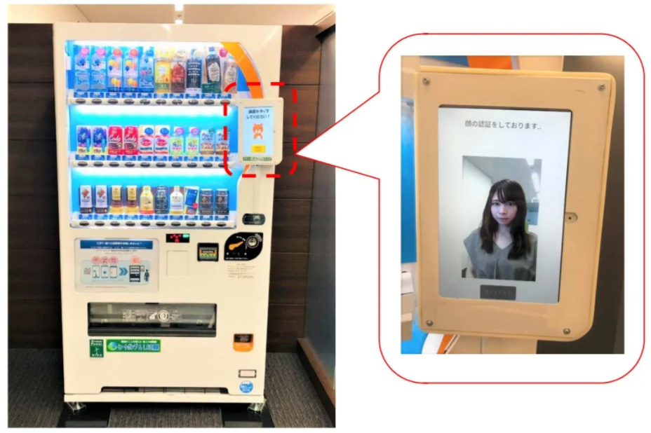
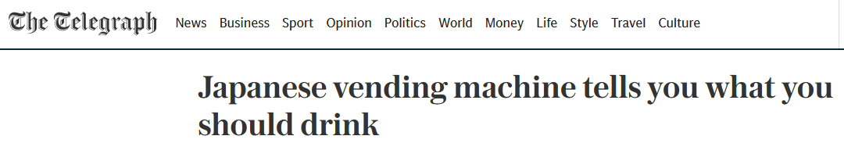
The Dystopian Future of Price Discrimination
Why are companies increasingly able to use first-degree price discrimination (personally tailored prices)? Any examples?
Is the trend towards more price discrimination good or bad for consumers?

Slide 13
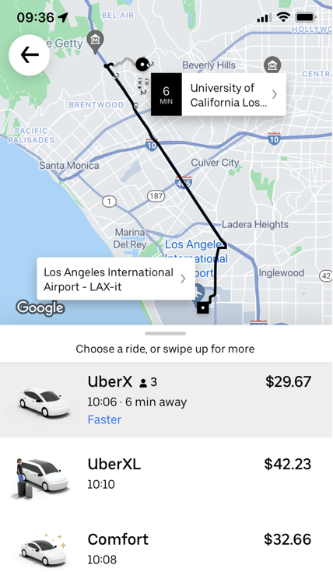
Uber Starts Charging What
You’re Willing to Pay?
I need 10 volunteers (5 for Uber, 5 for Lyft).
Open your Uber/Lyft app.
Enter “LAX” in the destination address.
Do NOT hit request.
Just tell me the UberX/Lyft price.
?

Slide 14
Third degree price discrimination: segment pricing (group pricing)
Price
  Divide customers into different groups with different price sensitivities
  Charge each group different prices (lower prices to more elastic groups)
P₁
Regular
movie-goers
P₂
Seniors
Demand

Slide 15

Consumer Segments in Medication
Lodine, a medication for arthritis, is used for both humans and dogs.
Which segment 'pays' a higher price?
Poll Everywhere Break
Notes:
For next slide: the price of Lodine for humans is three times the price for animals

Slide 16
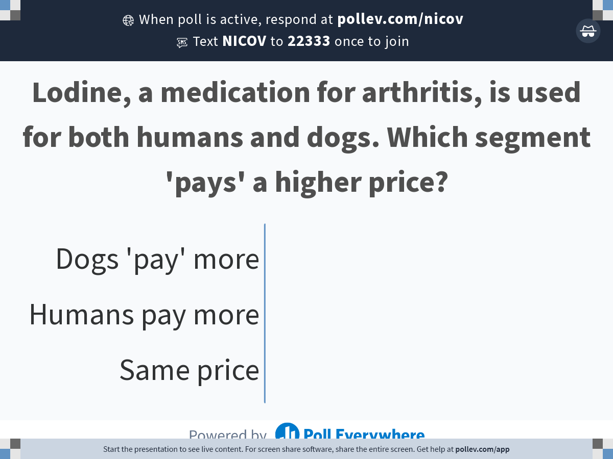
Notes:
Poll Title: Do not modify the notes in this section to avoid tampering with the Poll Everywhere activity.
More info at polleverywhere.com/support
Lodine, a medication for arthritis, is used for both humans and dogs. Which segment 'pays' a higher price?
https://www.polleverywhere.com/multiple_choice_polls/4BC5CeS5GrXrPVaYNwliJ?state=opened&flow=Default&onscreen=persist

Slide 17
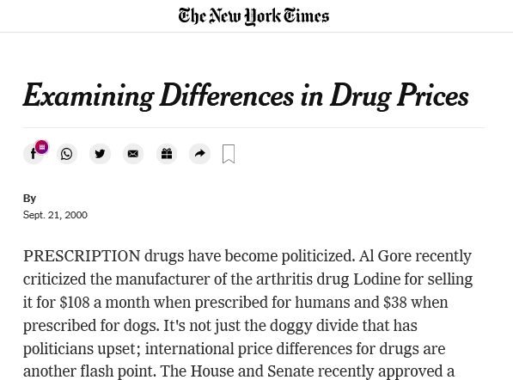
Solution
Higher price for humans!
Poll Everywhere Break
Notes:
For next slide: the price of Lodine for humans is three times the price for animals

Slide 18

Important: Segment Pricing Analytically
A firm produces the same product for two markets
Math:
Set MR_{i}=MC_{i} in each market i
Practice Video!
  Prices different if demand (MR) and/or costs (MC) are different
  Rule: Charge lower price in more elastic markets

Slide 19
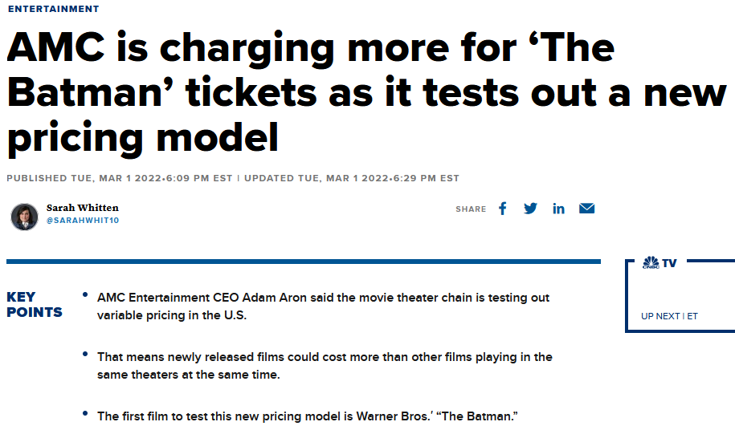
Segment Pricing in Movies
Higher prices for new movies
Notes:
For next slide: the price of Lodine for humans is three times the price for animals

Slide 20
OUTLINE of module 6
Simple vs. complex pricing
Direct price discrimination
  Perfect price discrimination (first degree)
  Segment pricing (third degree)
Indirect price discrimination (second degree)
    Versioning
  Coupons
Advanced pricing strategies
  Flat fee pricing
  Two-part tariff
  Block pricing

Slide 21
Second degree price discrimination:
Versioning
Indirect price discrimination
Charge different price for different versions of the product

Slide 22
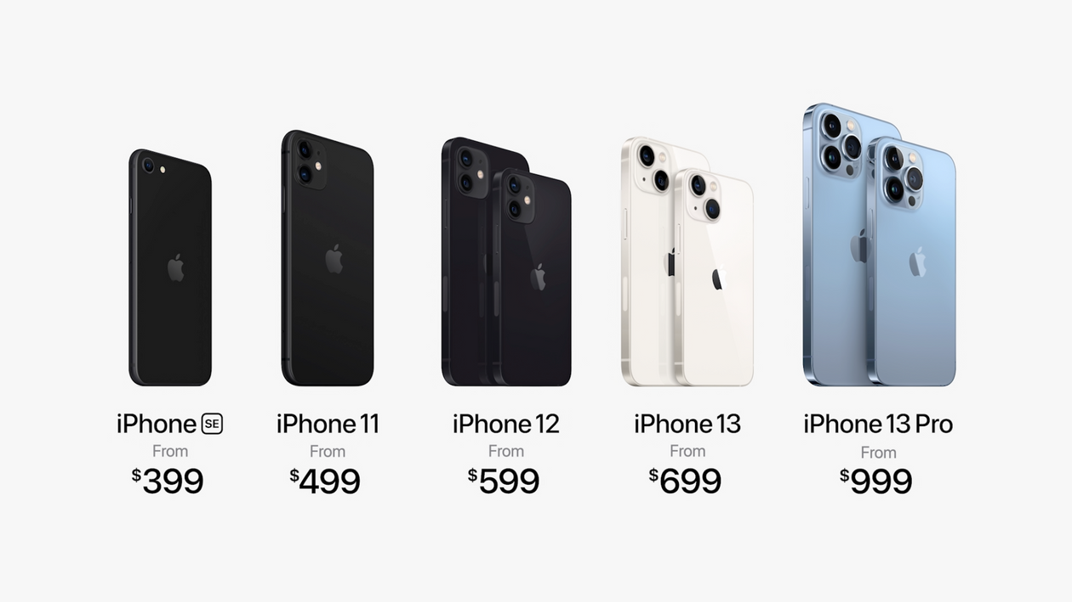
Recall: VErsioning
P/MPV
  Create different “versions” of your product
  Design them such that customers with different MPV “self-select” into the desired version
Version 1
P₁
Version 2
P₂
Version 3
P₃
Version 4
P₄
Version 5
P₅
Demand

Slide 23
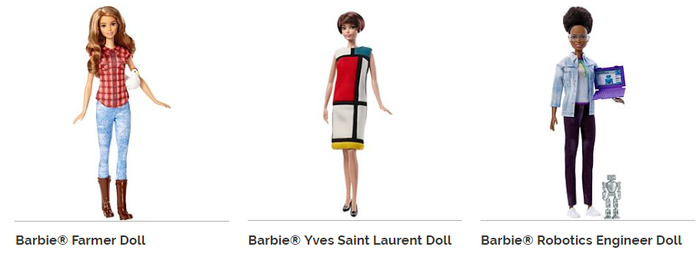



Versioning: dolls

Slide 24
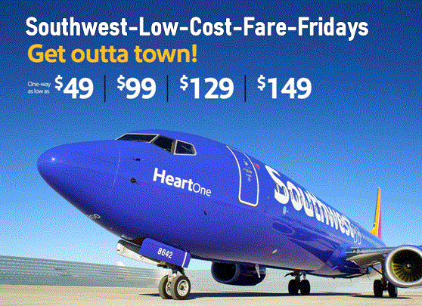
Airline Response to low-Cost Carriers
How should United respond to Southwest starting to offer flights on one of its routes?
Poll Everywhere Break

Slide 25
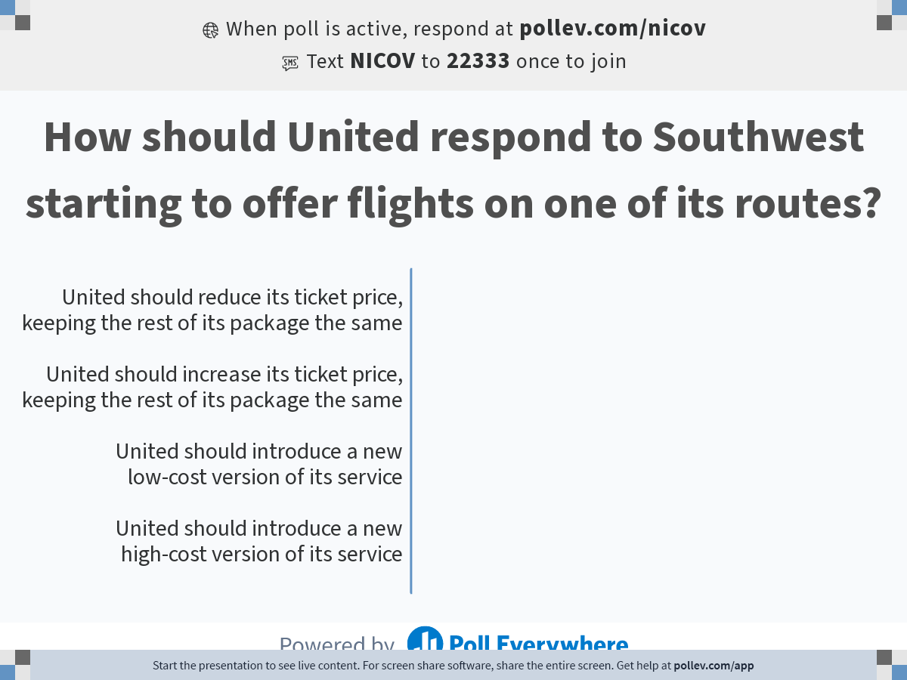
Notes:
Poll Title: Do not modify the notes in this section to avoid tampering with the Poll Everywhere activity.
More info at polleverywhere.com/support
How should United respond to Southwest starting to offer flights on one of its routes?
https://www.polleverywhere.com/multiple_choice_polls/kTjbo3Qwc1lQNUuHpIZ8D?state=opened&flow=Default&onscreen=persist

Slide 26

Versioning in Response to Low-Price Competition
Response by major US airlines to low-cost carriers (Southwest, Spirit):
  No “free” carry-on bag
  No advance seat assignments
  Don’t collect miles…
Compete with low-cost competitors by offering a low-cost / low-quality version of your own product
Not a new strategy. E.g.: Kodak Gold vs. FunFilm in the 1990s
More seating versions…
Notes:
Another Example: Fun Film sold at Price Costco. This is a classic example. Kodak was selling their premium Royal Gold film. Fuji and others started competing. Kodak wanted to protect the low end of their market. They could have lowered the price on Royal Gold, but then you give up capturing the surplus at the high end. So they introduced a new brand, FunFilm, offered only at discount stores like Sam’s Club, Costco, in bulk. This is where price sensitive customers go. It turns out the two films were chemically identical. The packaging and bulk sales aspect were different but the actual product was the same. This is a classic B-school case.

Slide 27
Podcast on Price Discrimination
Historically: Price discrimination by haggling
  Can it lead to perfect price discrimination?
  What’s the problem with haggling?
How does the NYC restaurant try to price discriminate?
  Regular price: $18
  MC of a burger+drinks is $4.50
  How much is the coupon?
  Does that make sense?
How do coupons relate to price discrimination?
Notes:
Coupon costs $9, but the restaurant gets only $4.50
Problems with haggling: -- Not incentive compatible…everybody tries to lie about their WTP
-- Takes very long to negotiate. So did not work in large department stores in late 19C

Slide 28
OUTLINE of module 6
Simple vs. complex pricing
Direct price discrimination
  Perfect price discrimination (first degree)
  Segment pricing (third degree)
Indirect price discrimination (second degree)
    Versioning
  Coupons
Advanced pricing strategies
  Flat fee pricing
  Two-part tariff
  Block pricing

Slide 29
Context
So far: We had different consumers with different demand curves (marginal personal value)
  Extract surplus via direct/indirect price discrimination
Now: Consumers have identical demand curves, but each of them purchases multiple units of the product
  We will focus on a “representative consumer”

Slide 30
Advanced Pricing
How to extract consumer surplus from a given consumer who is prepared to buy multiple units
Diminishing marginal personal value comes into play
We will study three variants of advanced pricing
  All-or-none offers (flat fee)
  Two-part tariffs (flat fee + usage fee)
  Block pricing

Slide 31
Example: Netflix flat fee (assume MC=0)
P
Yellow area = total value of unlimited movies for the consumer = maximum fee Netflix can charge
Area = (16x2)/2 = 16
Note: only makes sense when MC=0
$2
P=2-Q/8
Revenues
=$16
D
16
Movies
Notes:
With MC=0, people buy to where the value is zero. You want to capture the entire area under the demand curve. How much does the consumer pay? For a flat fee of $400, he would be just willing to purchase the bundle of 20 units. The company doubles their contribution and extracts all the surplus.
Equivalent pricing schemes: A sliding scale discount pricing scheme amounts to the same thing – charge lower and lower amounts for each subsequent unit sold. Here you march the consumer down the demand curve and you charge successively lower prices that allow you to capture all the surplus. The quantity discounts come from the seller’s realization that the buyer has a downward sloping demand curve.

Slide 32
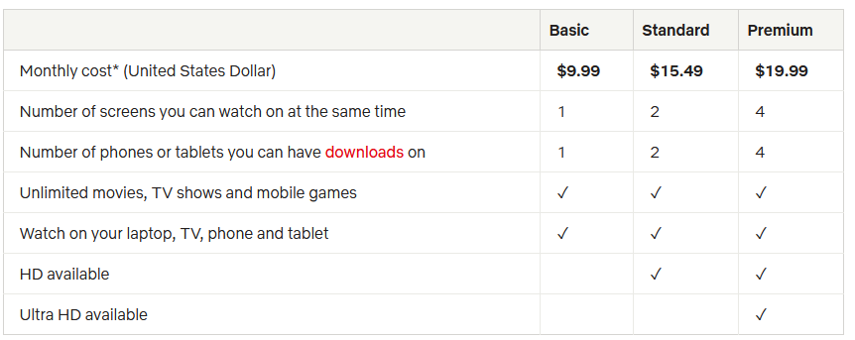
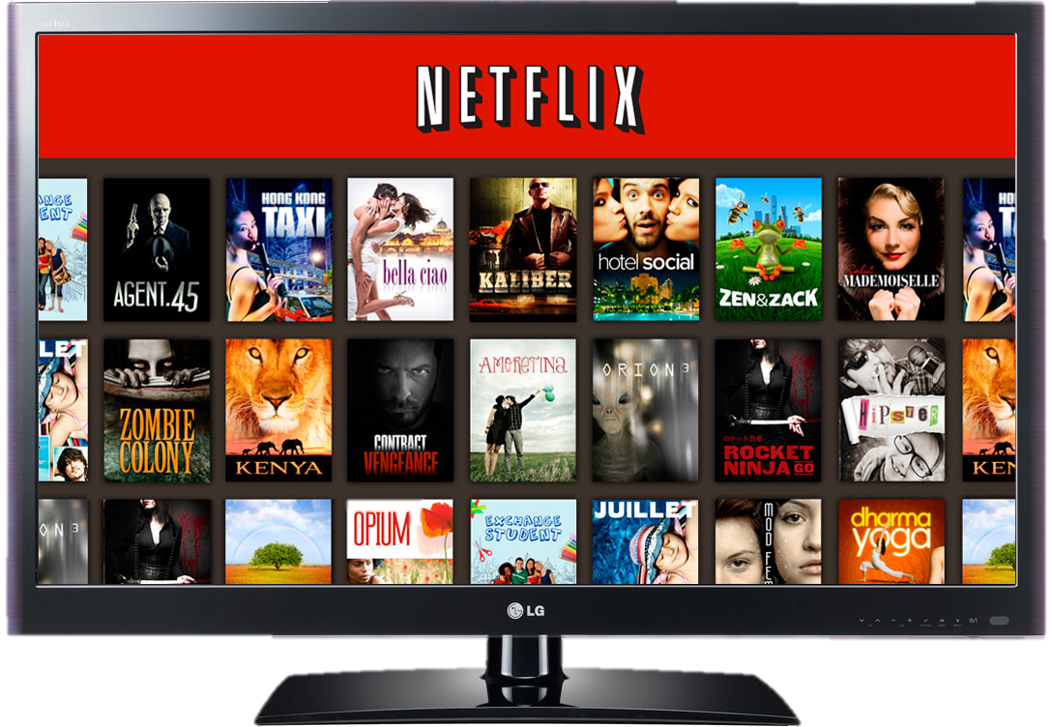
Netflix pricing strategy
  Note that this pricing strategy is a mix of flat fee and versioning
Notes:
This chart represent the pricing strategy of Netflix, as an example of versioning. They have three plans, from basic to premium. The chart on the right represents the change in strategy that Netflix followed over time
This is a very good video on increase in price in 2017, where they also discuss previous price increases and the backlash associated with them
https://finance.yahoo.com/news/netflix-price-hikes-wont-hurt-subscriber-growth-211526185.html

Slide 33
WSJ Article on Netflix
  What’s wrong with the following statement?

Slide 34
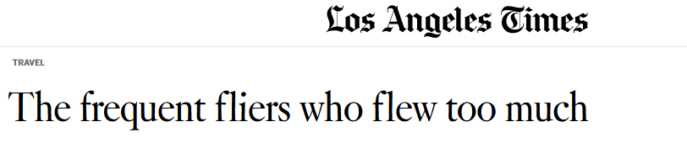
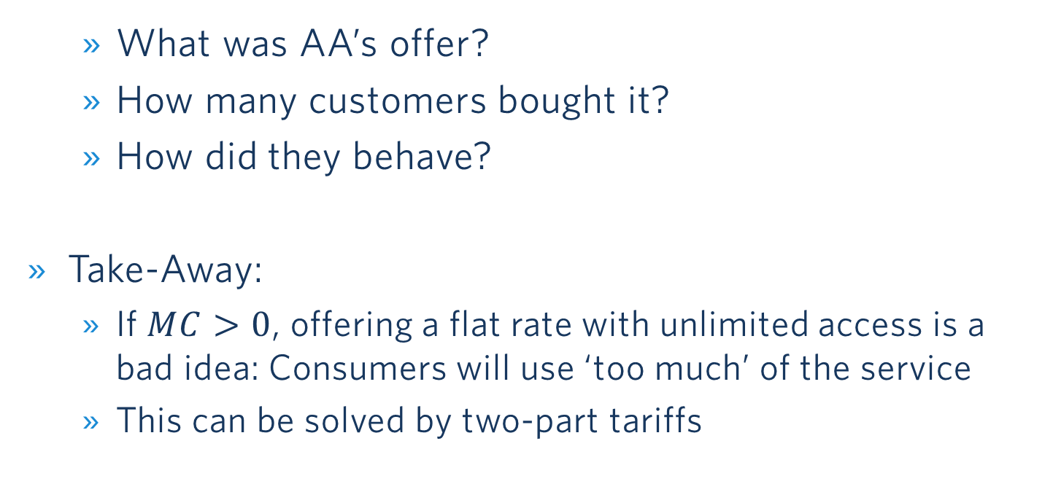
What can Go Wrong with Flat Rates…
  What was AA’s offer?
  How many customers bought it?
  How did they behave?
Take-Away:
  If $MC>0$, offering a flat rate with unlimited access is a bad idea: Consumers will use ‘too much’ of the service
  This can be solved by two-part tariffs

Slide 35
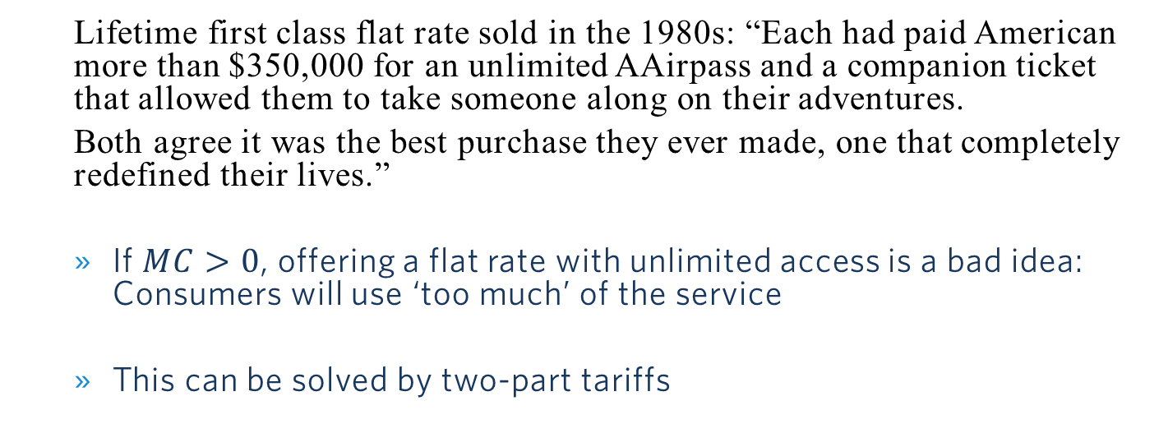
What can Go Wrong with Flat Rates…
  Lifetime first class flat rate sold in the 1980s: “Each had paid American more than $350,000 for an unlimited AAirpass and a companion ticket that allowed them to take someone along on their adventures.
  Both agree it was the best purchase they ever made, one that completely redefined their lives.”
  If $MC>0$, offering a flat rate with unlimited access is a bad idea: Consumers will use ‘too much’ of the service
  This can be solved by two-part tariffs

Slide 36
Two part-Tariff
Now: MC>0
P
Flat fee ,F*, is equal to the entire consumer surplus. Usage fee, P*, is set equal to MC.
F*
P*
MC
D
Q

Slide 37

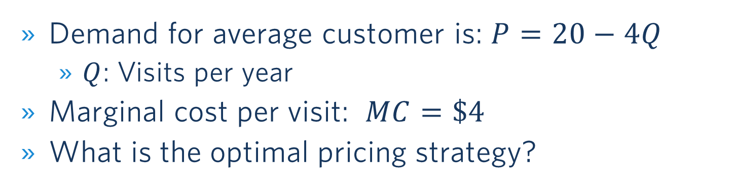
Pricing at a Local Zoo
Demand for average customer is: $P=20−4Q$
  $Q$: Visits per year
Marginal cost per visit: $MC=\$4$
What is the optimal pricing strategy?
Poll Everywhere Break

Slide 38
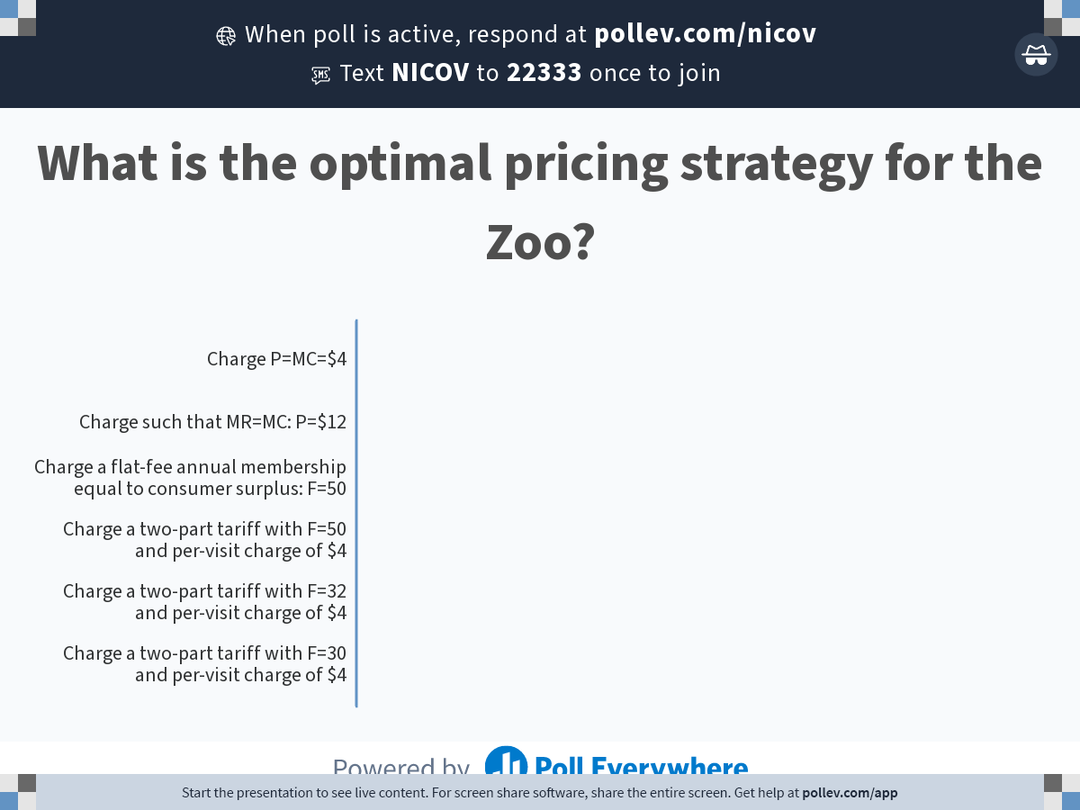
Notes:
Poll Title: Do not modify the notes in this section to avoid tampering with the Poll Everywhere activity.
More info at polleverywhere.com/support
What is the optimal pricing strategy for the Zoo?
https://www.polleverywhere.com/multiple_choice_polls/hmpajEICOBWnni2rKMoIs?state=opened&flow=Default&onscreen=persist

Slide 39

Zoo Pricing – Solution
P
Two-part tariff:
  Flat fee: F =$32
  Usage fee: P =$4/visit
Per-visit charge recovers the variable costs of $16
Profit: $32 per customer
(assuming zero fixed cost)
$$P=20−4Q⇒Q=5−0.25P$$
$20
Flat fee
=$(20-4)∙4/2
=$32
$4
MC
Per-visit charge
=$4∙4 = $16
D
5
4 (Q=5-0.25MC)
Q (visits per year)

Slide 40
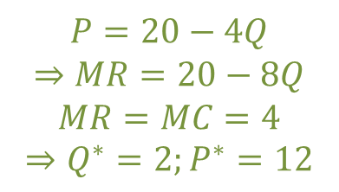
Zoo Pricing – Comparison to Simple Pricing
P
Simple Pricing:
  Profit: $16 per customer (assuming zero fixed cost)
$$P=20−4Q$$
$$⇒MR=20−8Q$$
$$MR=MC=4$$
$$⇒Q^{∗}=2;P^{∗}=12$$
$20
$12
Under simple
Pricing:
$16
$4
MC
D
2
5
MR
Q (visits per year)

Slide 41

Zoo Pricing – Comparison to Flat FEe
P
Flat-Fee Pricing:
  Flat fee: F =$50
Costs due to visits is $20
Profit: $30 per customer
(assuming zero fixed cost)
$20
$$P=20−4Q$$
Flat fee
=$20∙5/2
=$50
Overall 5 visits since price per visit is now zero
$4
MC
Variable cost due to visits
=$4∙5 = $20
D
5
Q (visits per year)

Slide 42
Block Pricing
Block pricing is the practice of reducing the price of a good when the same customer buys more of it

Slide 43
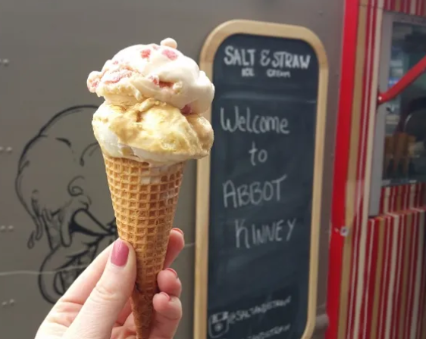
Block pricing: Ice Cream
Price ($/scoop)
Purchase options:
1 scoop for $4
2 scoops for $7
3 scoops for $8.50
$4.00
$3.00
A
B
$1.50
C
MC
$1.00
D
1
2
3
Q (scoops per customer)

Slide 44
How to extract consumer surplus?
A summary of pricing strategies
Does the firm have market power?
Perfect competition produces quantity at which MR = P = MC
No
Yes
Can the firm prevent resale and arbitrage?
No
Firm produces quantity (Q*) at which MR = MC, sets price P* where Q* = D(P*)
Yes
Advanced pricing strategies
• Flat-fee
• Two-part tariff
• Block pricing
Do the firm's customers have different demand curves?
No
Yes
Can the firm directly identify different customers?
Indirect (second-degree) price discrimination
• Versioning
• Coupons
Direct price discrimination
Yes
No
Firm has complete information about every customer
-----------------------------------------
Perfect (first-degree) price discrimination
Firm has information on groups of customers
-----------------------------------------
Segmenting (third-degree) price discrimination
Source: Goolsbee, Levitt, Syverson

Slide 45
Some Examples for Innovative Pricing Strategies
(only if We have Time)

Slide 46
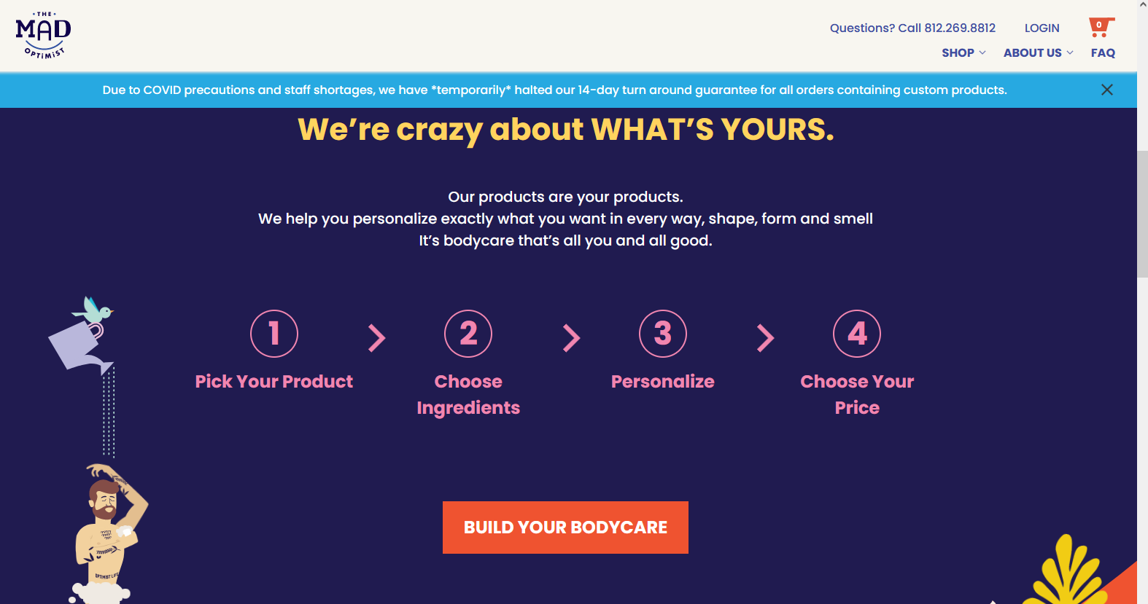
The mad optimist
An interesting way to extract consumer surplus
Notes:
Attempts to extract consumer surplus

Slide 47
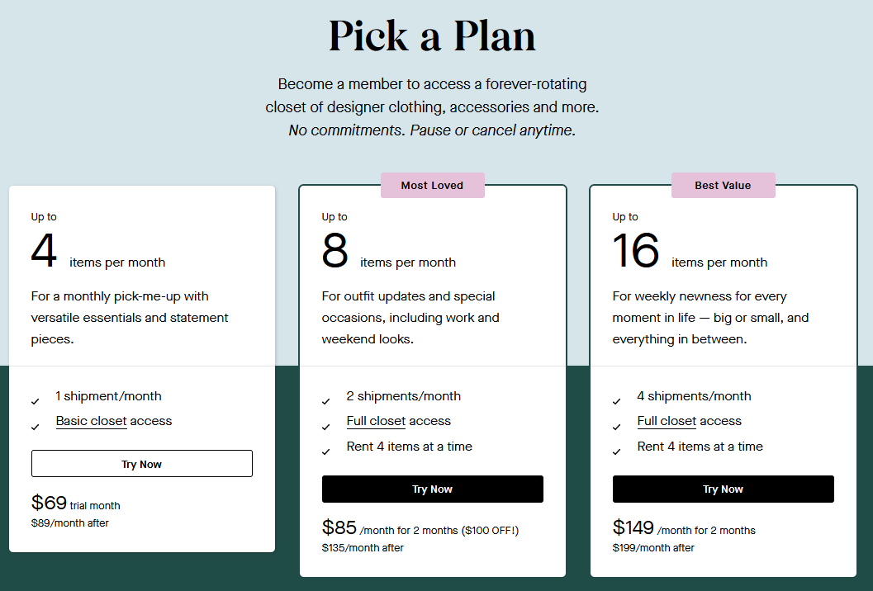
Rent the runway
Combination of block pricing and versioning
Notes:
Combination of block pricing and versioning

Slide 48
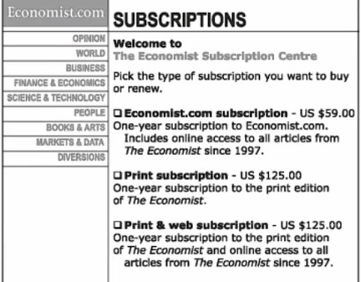
The economist pricing example
What do you think about this pricing strategy?
→ 16%
→ 84%
Attention focused on the comparison between the two $125 options
Notes:
The experiment was as follows,
- In one case consumers saw two options at 125 one including only print and one including print and web, and one at $59.
- In the other treatment consumer were given two options: $59 and $125 for print and web.
When people saw the three options 84% of them chose print and web and only 16% the cheapest option. Their attention went to the comparison between the two options at 125.
In the experiment with two options only 32% of them chose the expensive option, most of the (68% chose the $59 option)
Explanation: https://cxl.com/blog/pricing-experiments-you-might-not-know-but-can-learn-from/

Slide 49
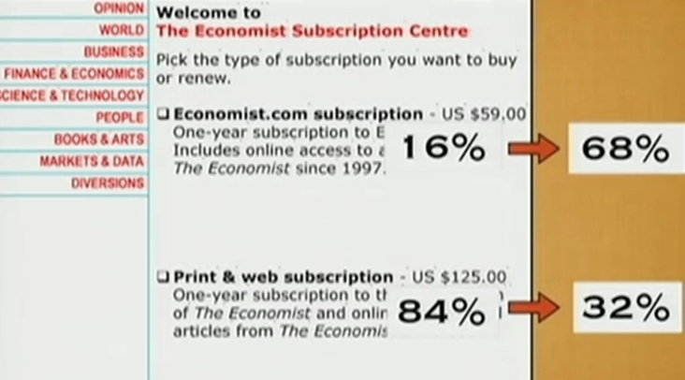
Dan Ariely’s experiment
Attention on the comparison between $59 and $125
Notes:
Explanation: https://cxl.com/blog/pricing-experiments-you-might-not-know-but-can-learn-from/

Slide 50
Module 6 summary
Limitations of simple pricing
Direct price discrimination
  Personalized pricing (first degree). Hypothetical.
  Segment pricing (third degree)
    Higher price to less elastic groups
Indirect price discrimination
  Versioning and coupons (second degree)
Advanced pricing strategies:
  If MC=0: Flat fee and unlimited access (e.g., Netflix)
  If MC>0: Two-part tariff (flat fee + usage fee)
    Usage fee = MC to avoid excessive use
    Flat fee = area under the demand curve above the per-unit fee
  Block pricing

Slide 51
Backup

Slide 52
